Slide 1
Approximate circuits
A variety of performance characteristics can be estimated simply, and with reasonable accuracy using approximate circuits.
Two of such circuits are as follows:

Slide 2
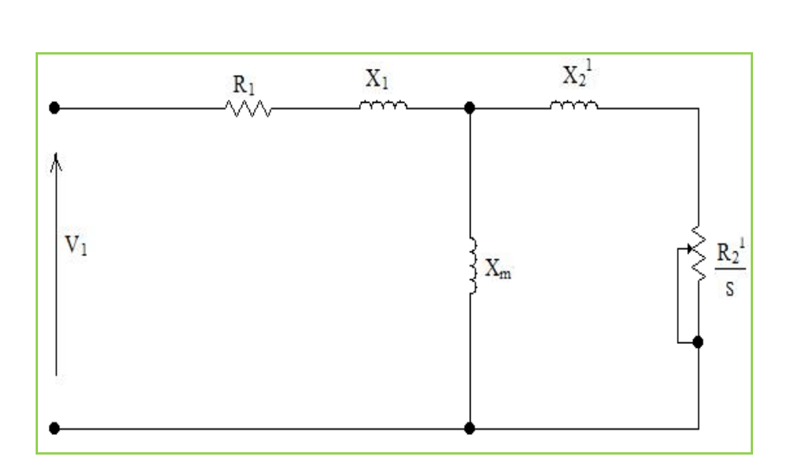

Slide 3
This circuit on the previous slide is IEEE recommended equivalent circuit.
The core loss is lumped with the mechanical losses.
Lumped together the losses are referred to as rotational losses.

Slide 4
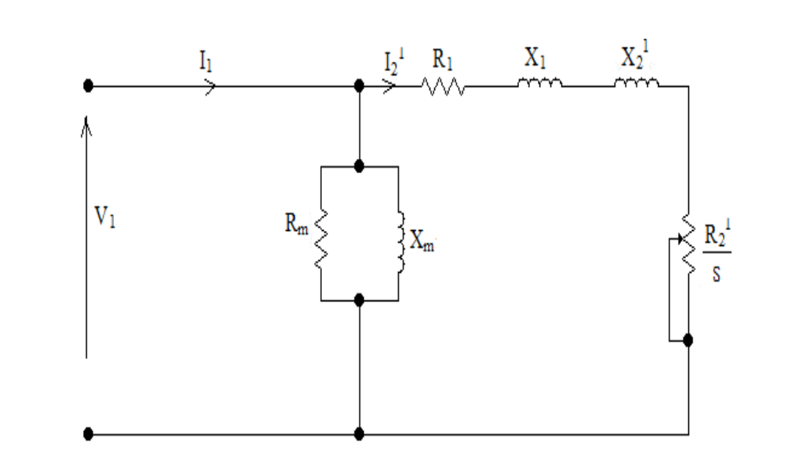

Slide 5
The voltage drop due to I_{o} flowing through the stator leakage impedance is appreciable.
Its exclusion in the circuit on the previous slide, can give rise to errors of 10 % or more in some cases.
It is acceptable for motors above 5 hp or 3 kW.

Slide 6
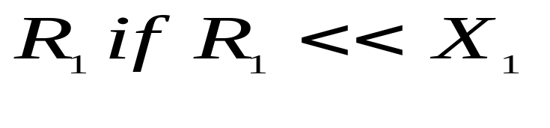
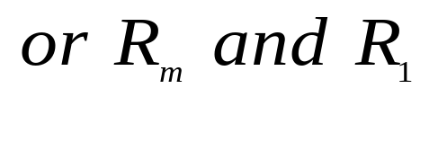
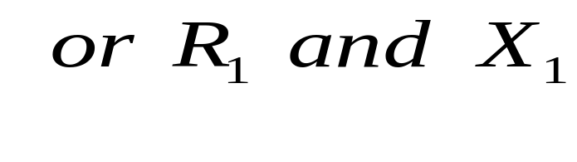
Approximate circuits cont’d.
Other approximations can be derived from the exact equivalent circuit by omitting
The last one implies that the mutual flux is constant. This gives very large errors at high values of slip.

Slide 7
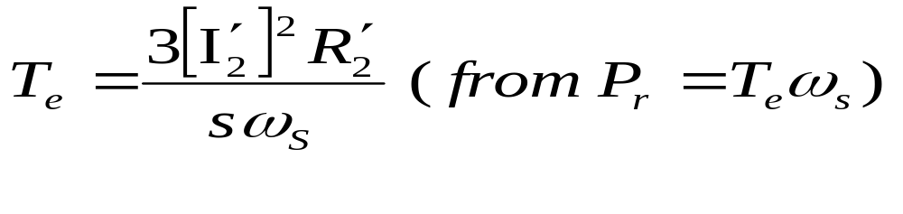
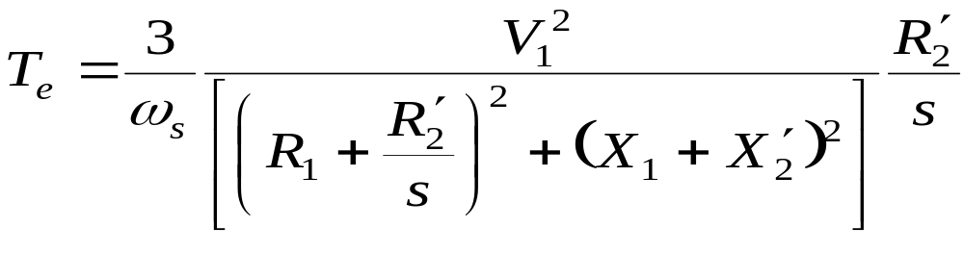
Torque calculations
The torque is given by
Consider approximate circuit no. 2.
In terms of the circuit parameters the torque is given by

Slide 8
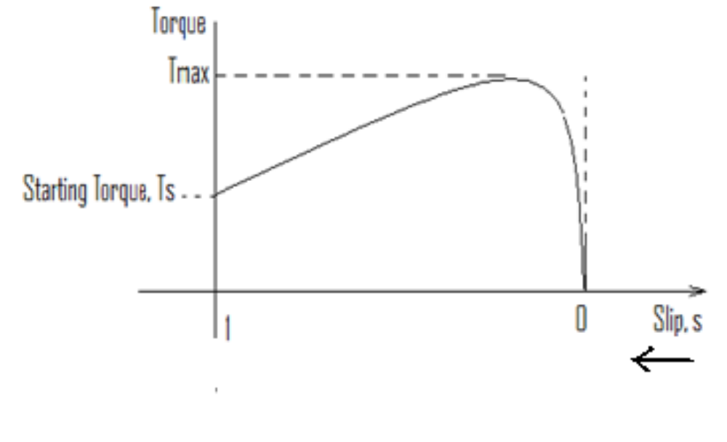
Torque calculations cont’d.
The general shape of the torque-slip curve for an induction motor is

Slide 9
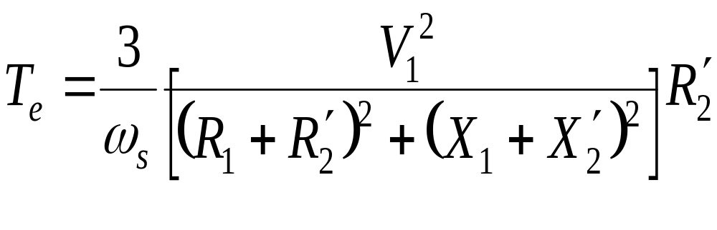
Torque calculations cont’d.
Starting torque
At starting s =1 and
For a given starting torque there are two possible values of rotor resistance. Why?

Slide 10
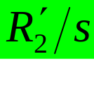
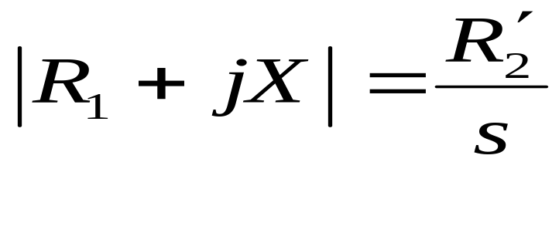
Maximum torque (T_{max} )
T_{max} is called the breakdown torque
To obtain the slip at which the maximum torque occurs, we use the fact that the torque is maximum when the power dissipated in is maximum and then apply the maximum power transfer theorem:

Slide 11
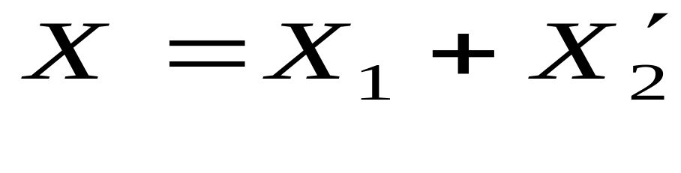
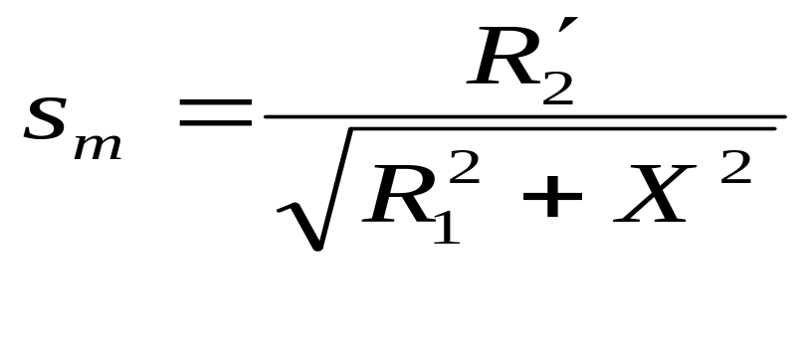
Maximum torque (T_{max} ) cont’d
Where
Thus the slip s_{m} at which maximum torque occurs is given by

Slide 12
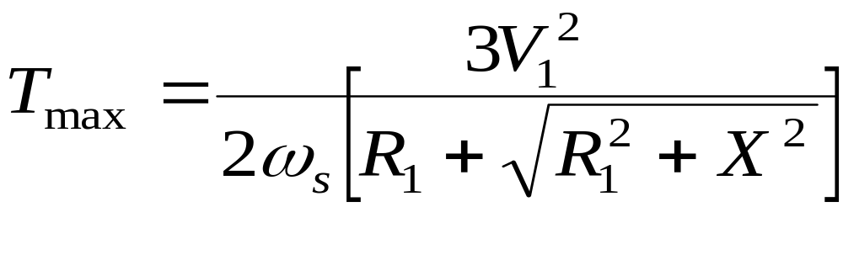
Maximum torque (T_{max} )cont’d
From s_{m} and the general torque equations, the value of maximum torque T_{max} is obtained as

Slide 13
Maximum torque (T_{max} )cont’d
We make the following observations:
  s_{m} is proportional to the rotor resistance but T_{max} does not depend on it.
  the speed of an induction motor can be controlled by varying the rotor resistance
  the starting torque can be increased by increasing the rotor resistance.

Slide 14
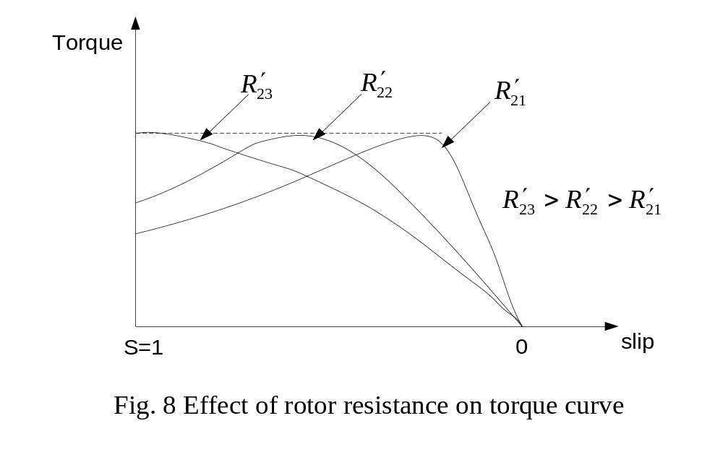
Typical torque-slip curves with variable rotor resistance are shown below:

Slide 15
Beyond R’₂₃ the starting torque starts decreasing. Thus for a given starting torque we notice here too that there are two possible values of rotor resistance.
The smaller rotor resistance is used to give larger accelerating torque at starting.
With a motor having a low-resistance rotor, such as the usual type of cage rotor, the starting torque is small compared with the maximum torque available.

Slide 16
A high rotor resistance is desirable because it produces a high starting torque. Unfortunately, it also produces a rapid fall-off in speed with increasing load.
Furthermore, because the slip which results at rated torque is high, the rotor copper losses are high, the efficiency is low and the motor tends to get hot.

Slide 17
When a high starting torque is required for a heavy starting duty such as accelerating a high inertia load from standstill to its running speed, the slip-ring is ideal.
Referring to the figure on the next slide, at starting the variable resistors are set to their highest value. As the motor accelerates, the resistance is gradually reduced until full-load speed is reached whereupon the brushes are short-circuited.

Slide 18
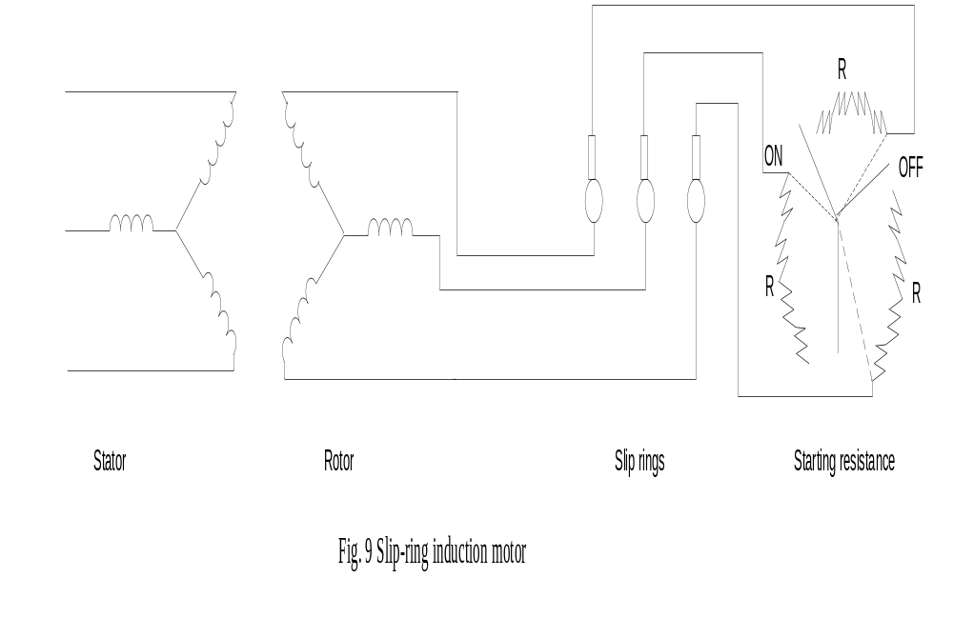

Slide 19
Comparison of cage and slip-ring motors
Advantages of squirrel-cage motors
Cheaper and more robust
Slightly higher efficiency and power factor
Explosion proof, since the absence of slip-rings and brushes eliminate risk of sparking

Slide 20
Comparison of cage and slip-ring motors cont’d
Advantages of slip-ring motors
The starting torque is much higher and the starting current much lower
The speed can be varied by means of external rotor resistor

Slide 21
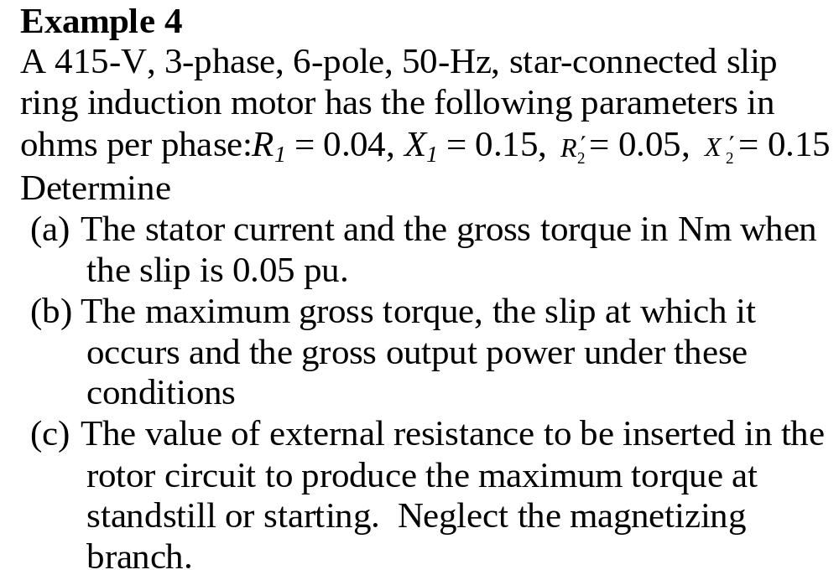

Slide 22
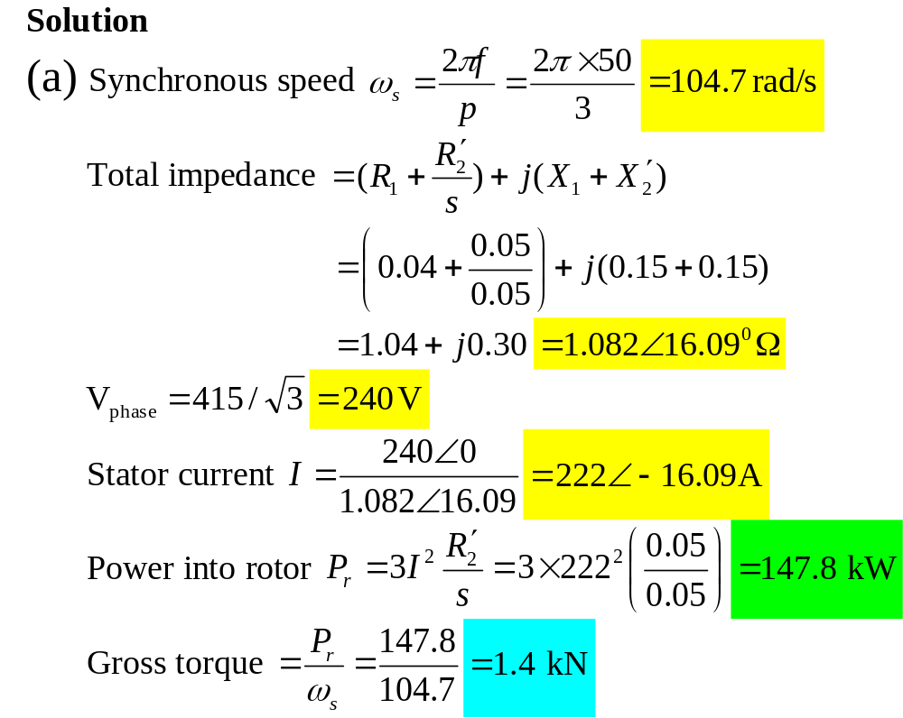

Slide 23
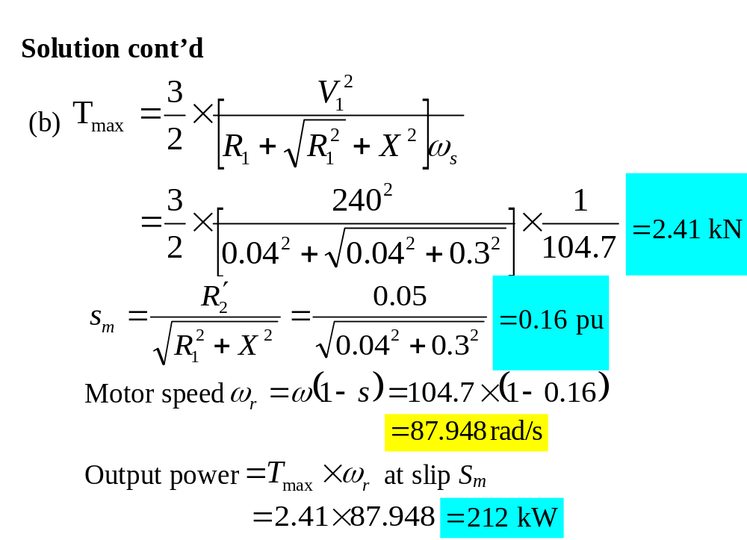

Slide 24
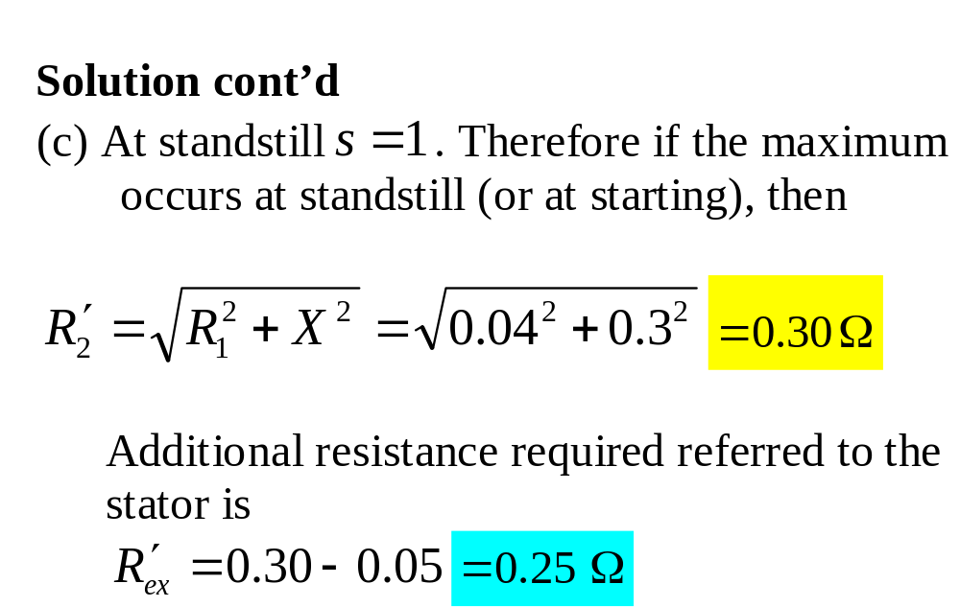

Slide 25
Determination of equivalent circuit parameters
The parameters of the motor equivalent circuit are determined from
  the measurement of dc phase resistance,
  and the locked rotor
  and the no load tests as follows:

Slide 26
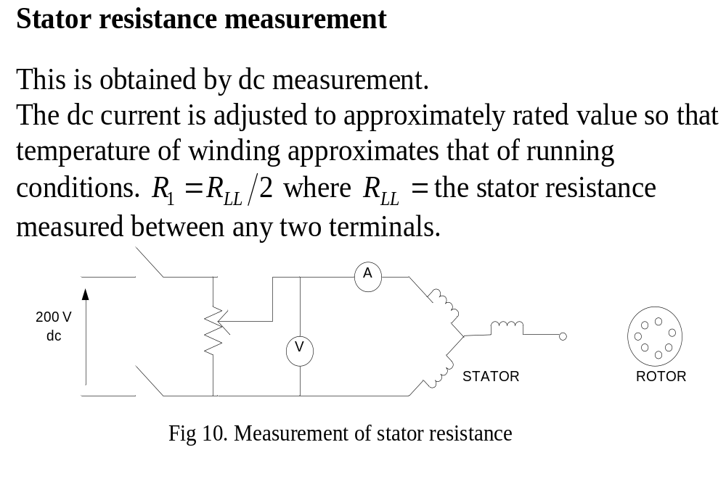

Slide 27
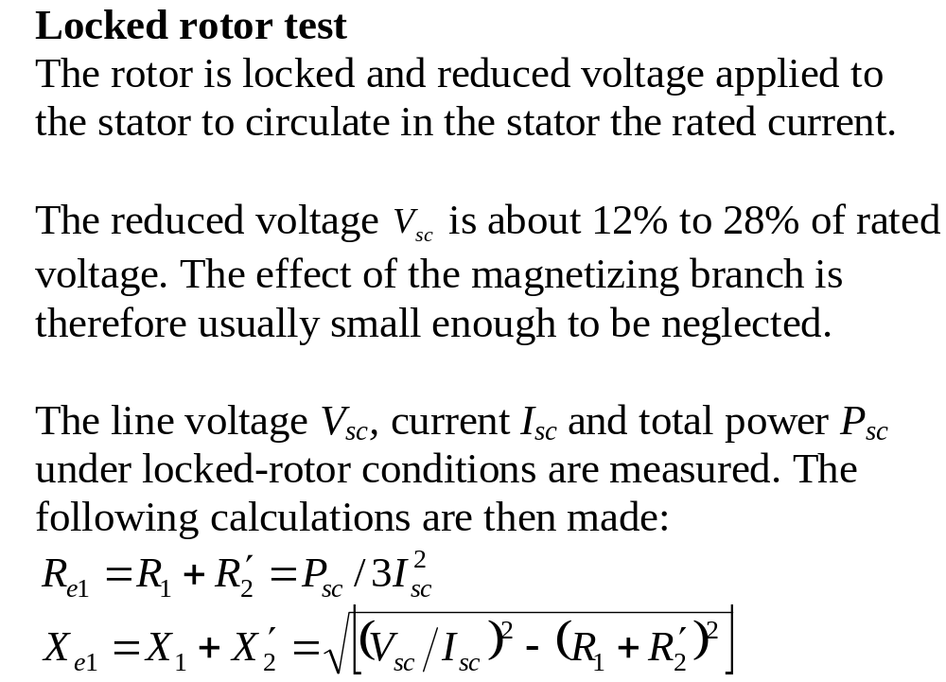

Slide 28
